Slide 1

WEEK 4
AGGP 231C
Application Development and Software Prototyping

Slide 2
Project - Timeline
Assignment 4 due September 28th
Concept due September 28th
Project due October 19th
 |  | Today
 | 9/28
 | 10/19

Slide 3

SCOPE
[ ]
QUALITY not Quantity

Slide 4


Project - Assets
Find free assets to use (like Robot Kyle)
Audio and Visual
An example of Quality is using the animations that come with a free character rather than having 50 unique non-animating characters
If Professor Walek has given you assets to use in other classes, those are accepted

Slide 5
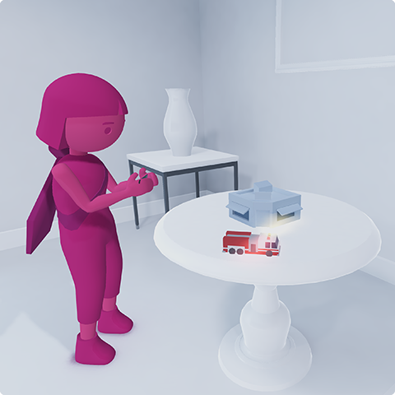
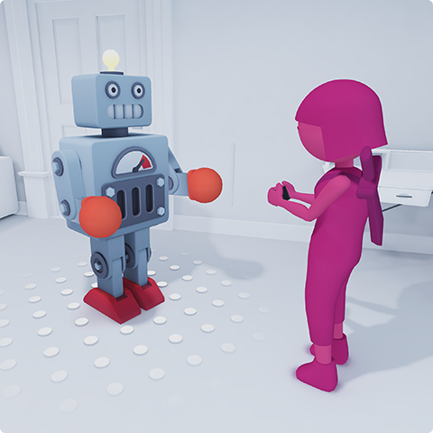
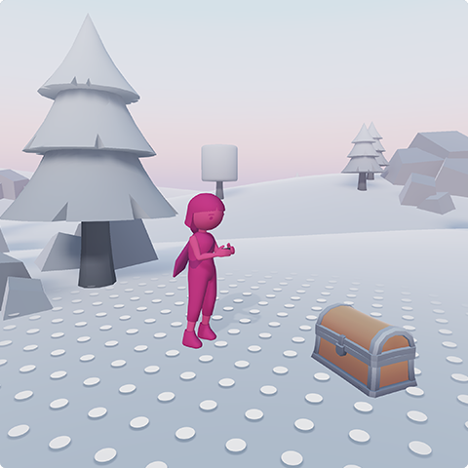
AR UI/UX – Define Size
Before you design your app, decide the size of the playspace.
Let the user know before play begins
Tabletop
Room
World

Slide 6
AR UI/UX – Movement
What type of movement should users expect to have.
Let the user know before play begins
How will you encourage user movement?
Example Movement Types
Seated, with hands fixed
Seated, with hands moving
Standing still, with hands fixed
Moving around in a real-world space
Design for Comfort
Don’t make them walk backwards
Nothing physically demanding

